Slide 1

Time Capsule
Will Crowley

Slide 2

Items that happened in the semester individually, with friends, groups, locally, nationally

Slide 3
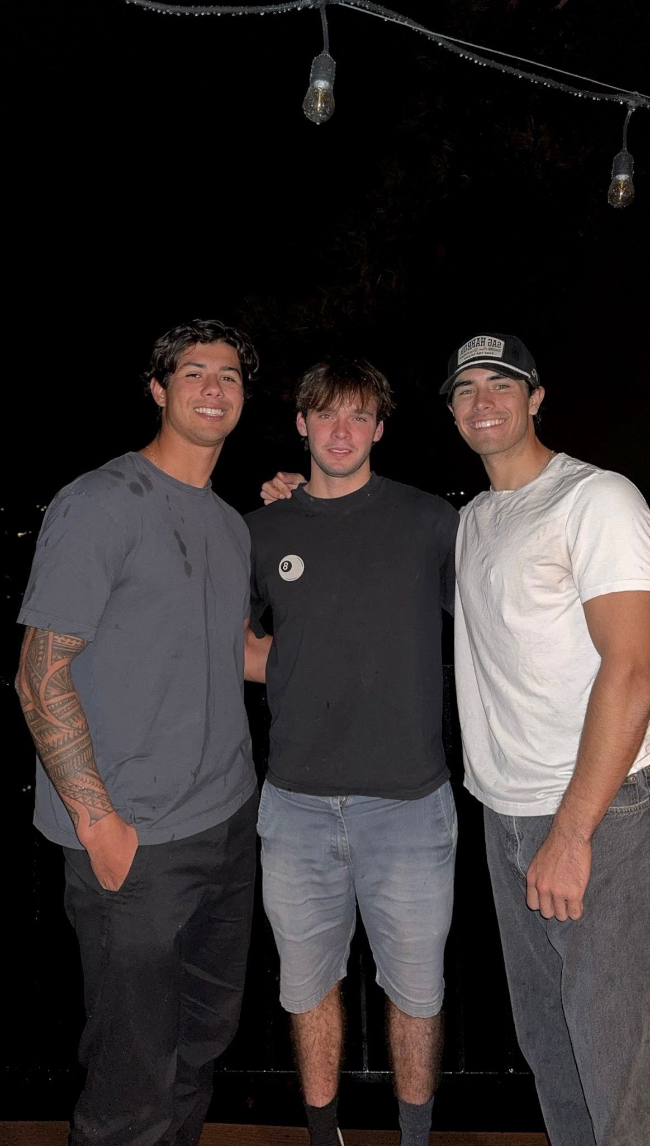
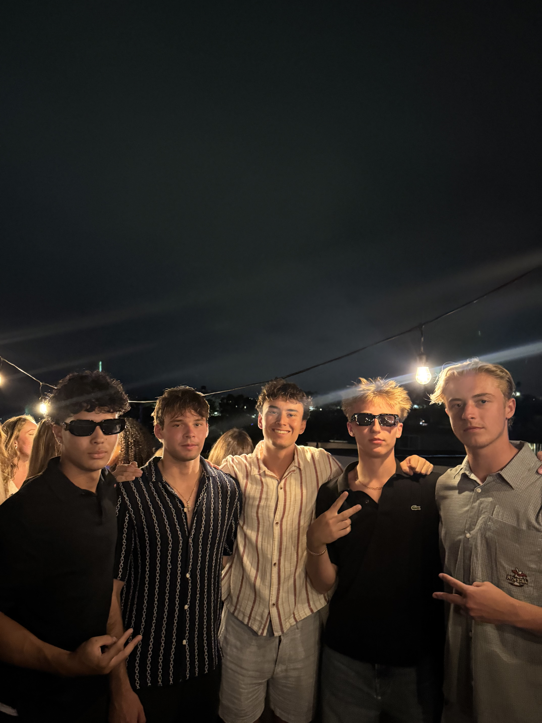
I met some great friends, on the right is my roommate Nolean as well as some of my first friends here, and on the left are some of my friends in Delt.

Slide 4
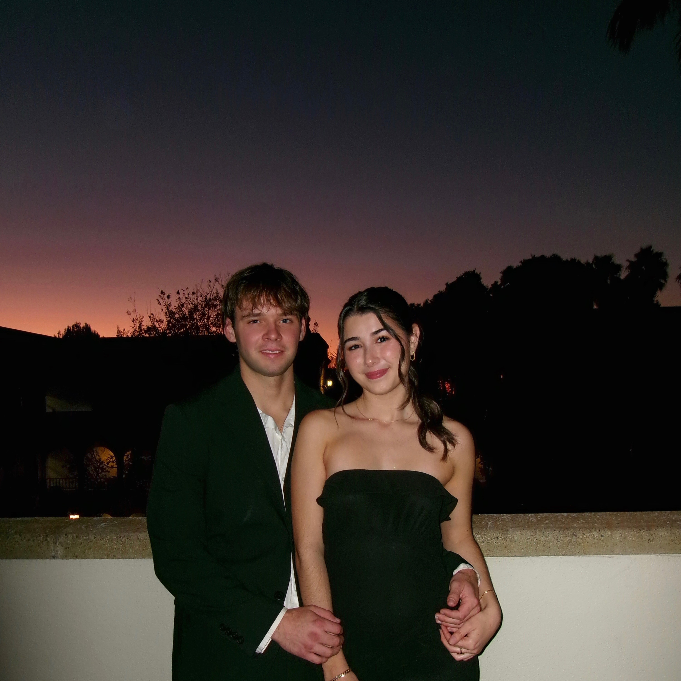
I met my girlfriend Eavan. I spent a lot of time with her this semester.

Slide 5
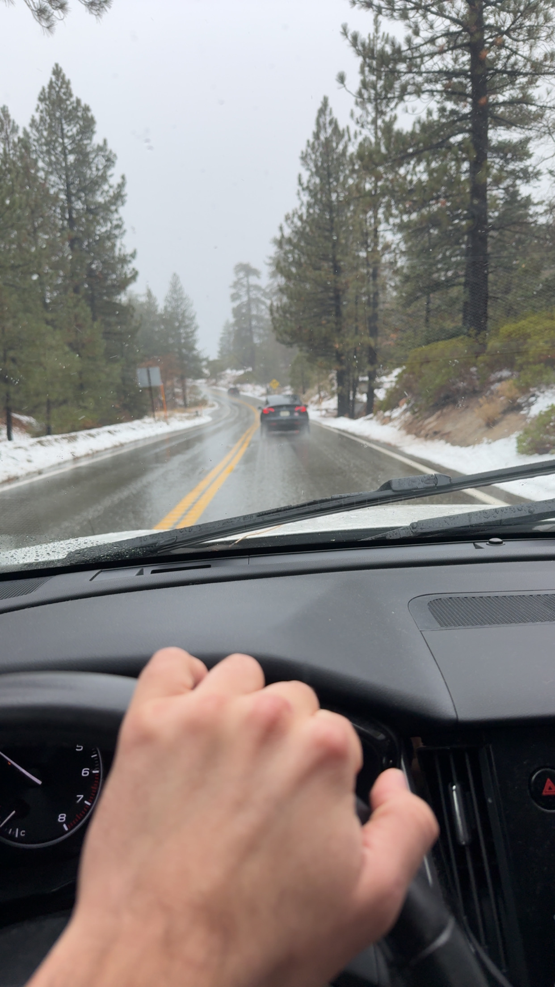
I went on a big bear trip with some of my friends

Slide 6

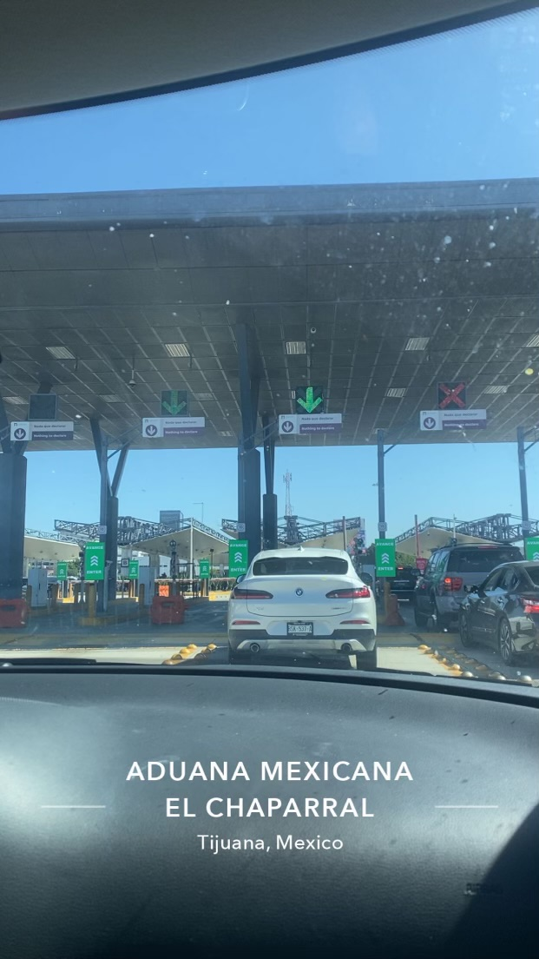
I went to Tijuana with my roommate. Exploring a city in a different country is always a fun time.

Slide 7

Items that you experienced that have touched your life this semester in an positive way

Slide 8
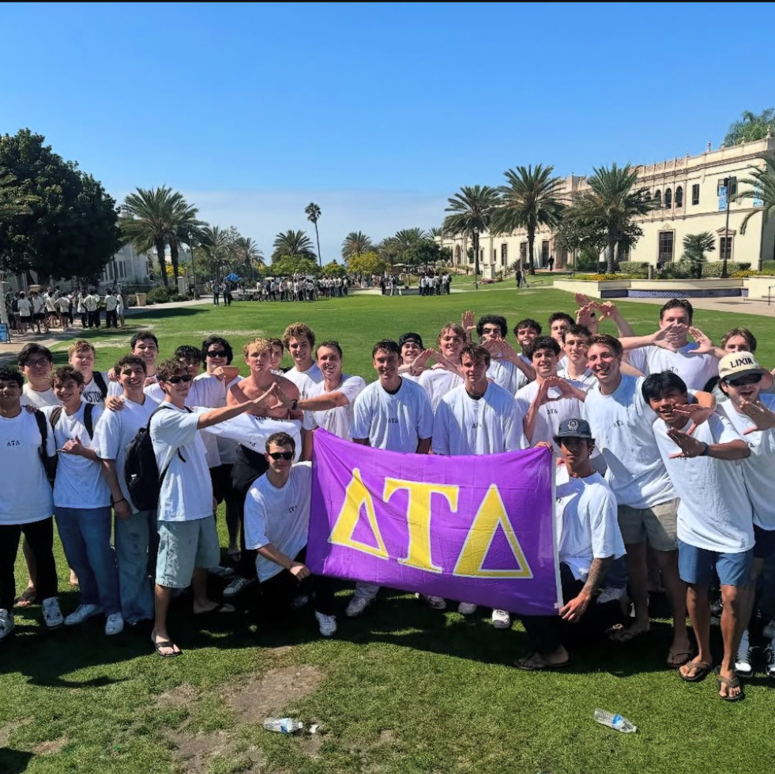
I joined Delta Tau Delta. Joining was a great experience; I made a lot of friends and lifelong connections.

Slide 9

I read ”Blindness” by Jose Saramago. Reading it was definitely an insightful experience about human nature

Slide 10

Items that illustrates people’s creativity to assist others

Slide 11
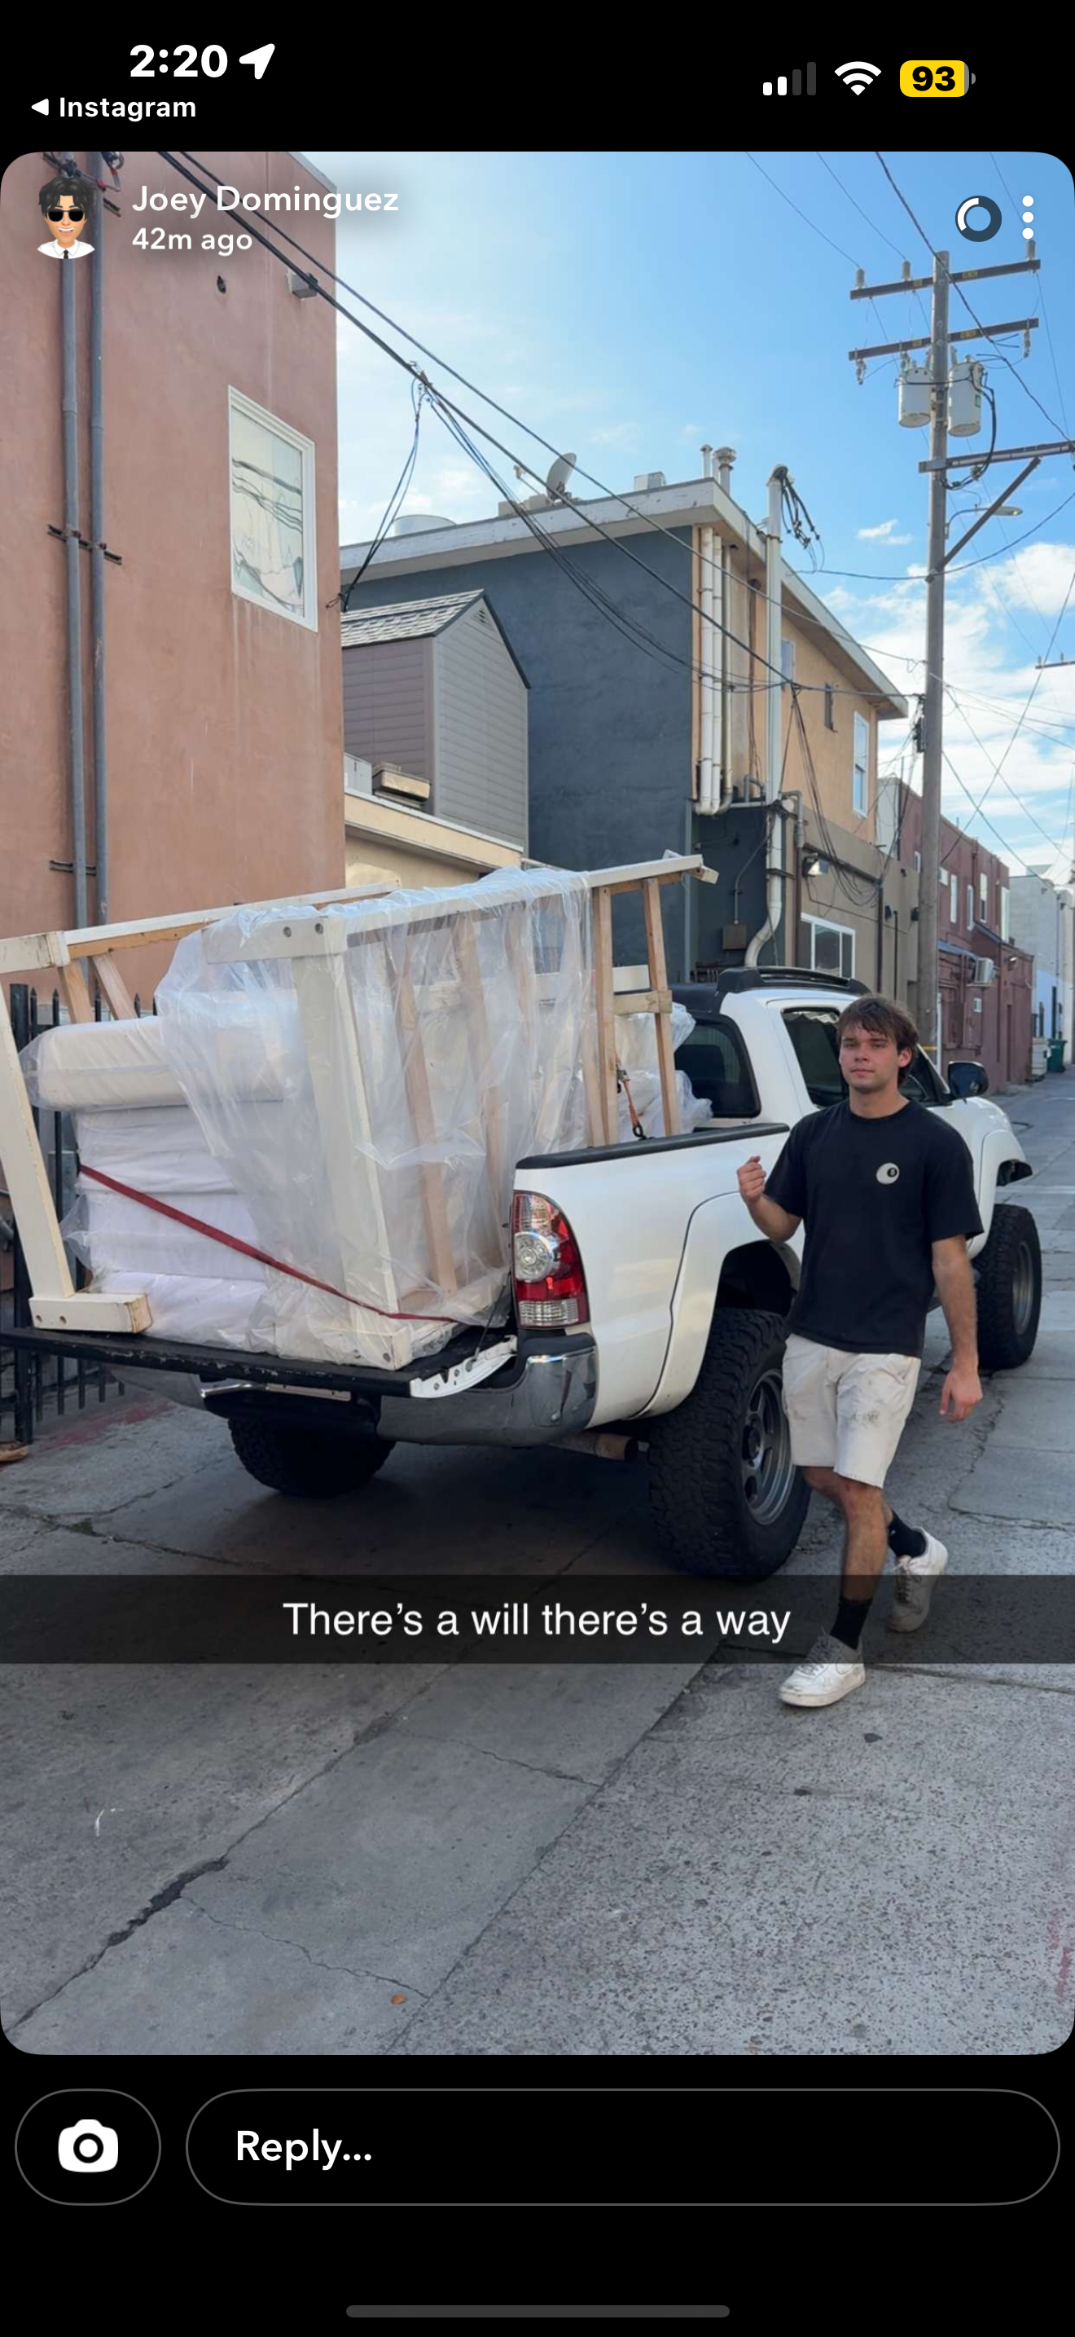
I helped my friend Joey move into his house. We had to be very creative on how to fit bed frames and mattresses into his truck Bed

Slide 12
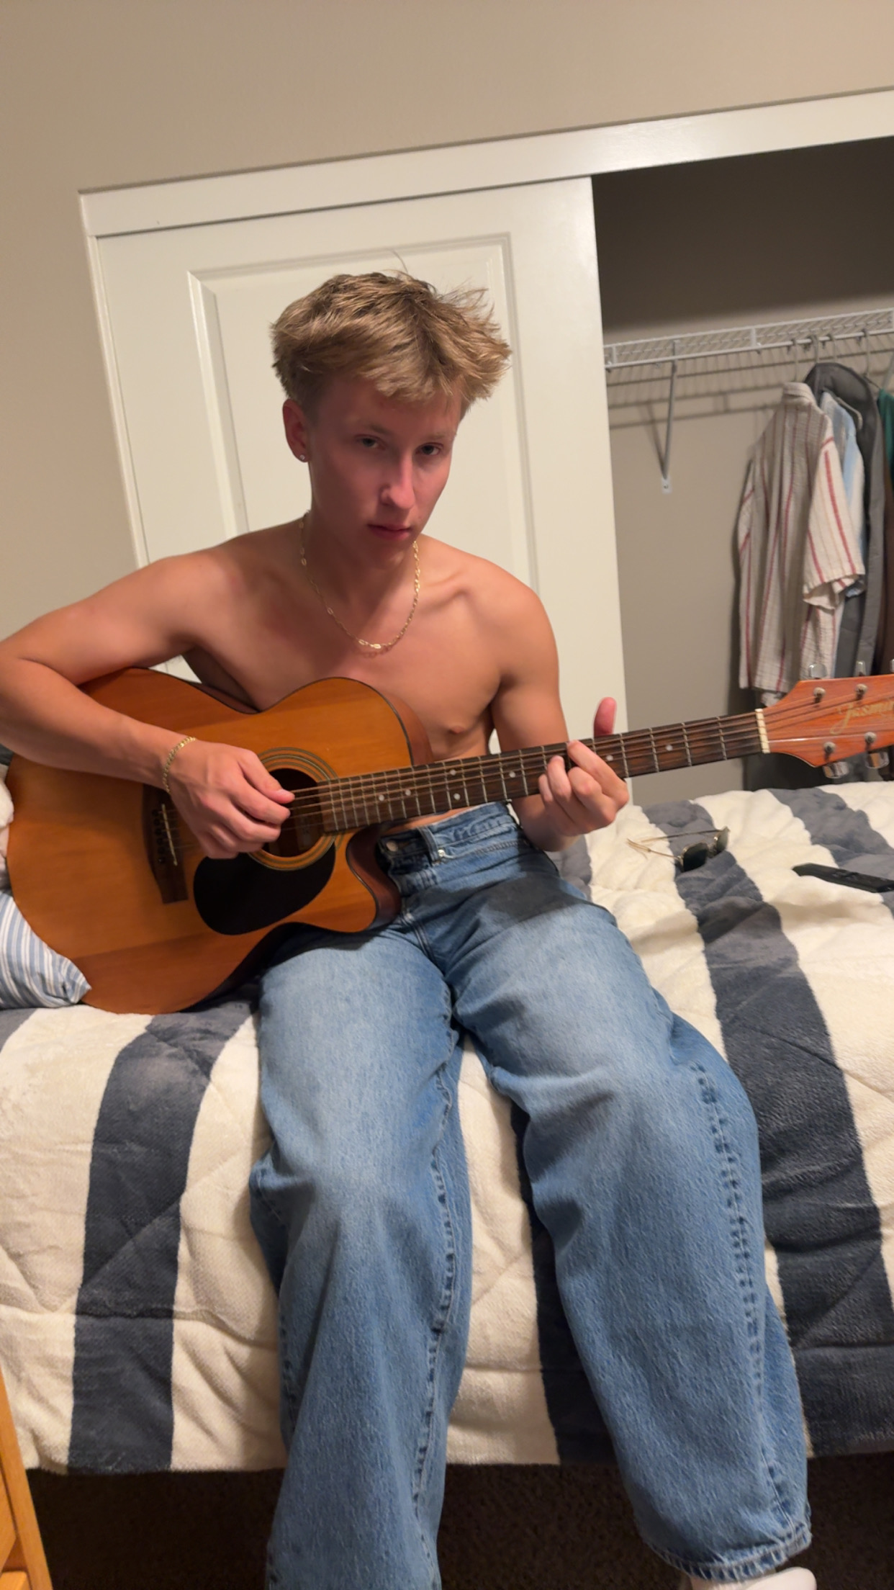
I taught my friend Bridger how to play guitar. The recording is him finally getting Everlong down.

Slide 13
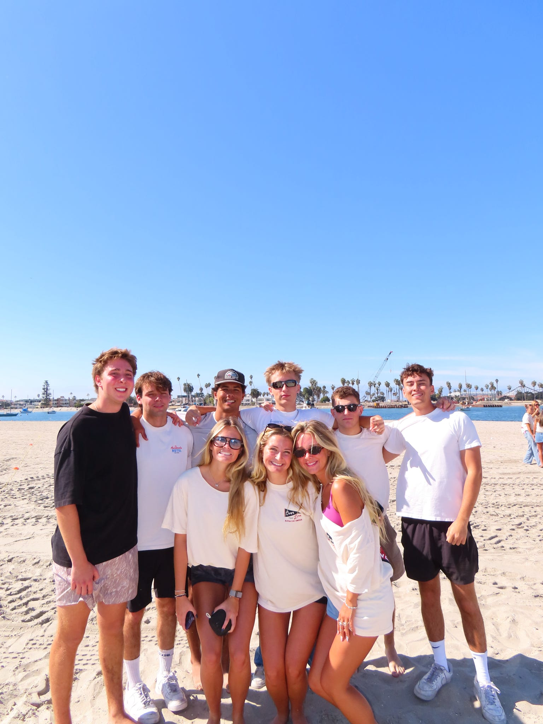
My friends and I participated in Alpha Chi Omega’s Over the Line tournament. Alpha Chi Omega runs this for their philanthropy work. We played wiffleball.

Slide 14

Items that you experienced that were sad or negative that you wish not to be experienced again

Slide 15
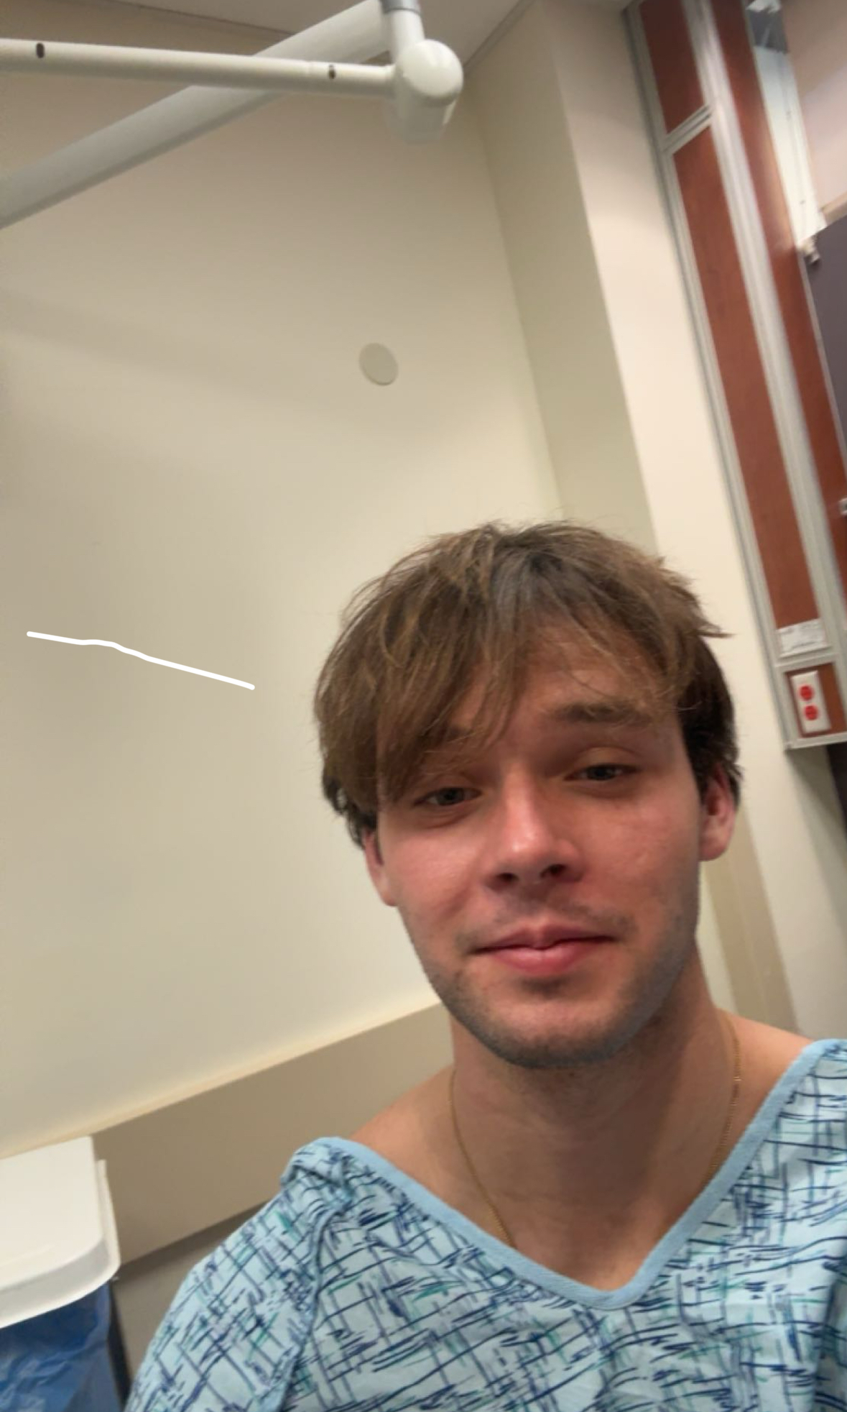
I spent my birthday in the Hospital. Not a fun experience at all.

Slide 16
Items that did not happen that you wanted

Slide 17
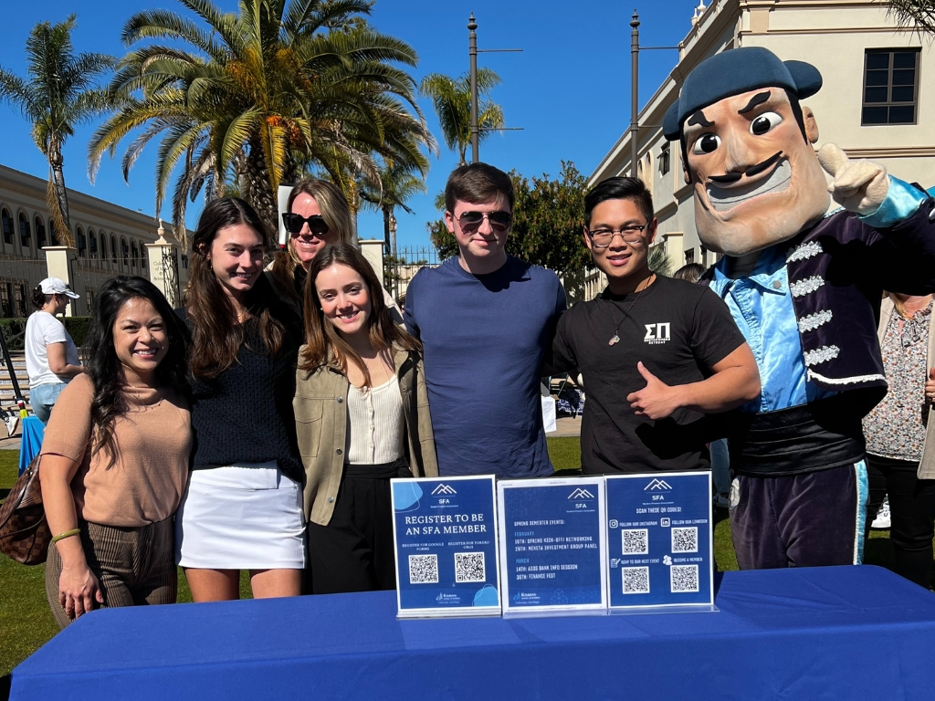
I unfortunately did not join any clubs, but I plan to next semester.

Slide 18


I ran out of dining dollars

Slide 19

Items that were highlighted by news, media advertisements/messages, government, other countries, other sources

Slide 20

In 2025, the government shutdown happened because leaders couldn’t agree on a budget, so some government offices closed and workers were sent home for a while.

Slide 21

Items that illustrates changes to processes (buying food other items)

Slide 22

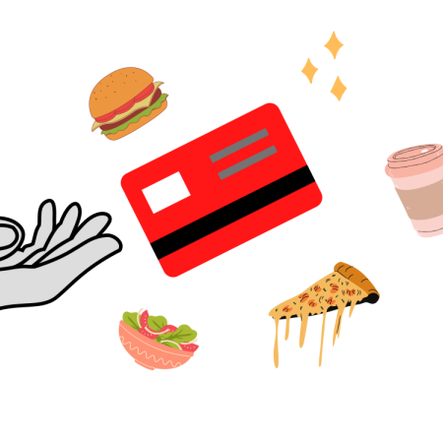
I had to get used to using dining dollars and meal swipes

Slide 23

Other relevant items to discuss the semester you had, the semester you wanted, and the semesters that you wish to have in the future.

Slide 24
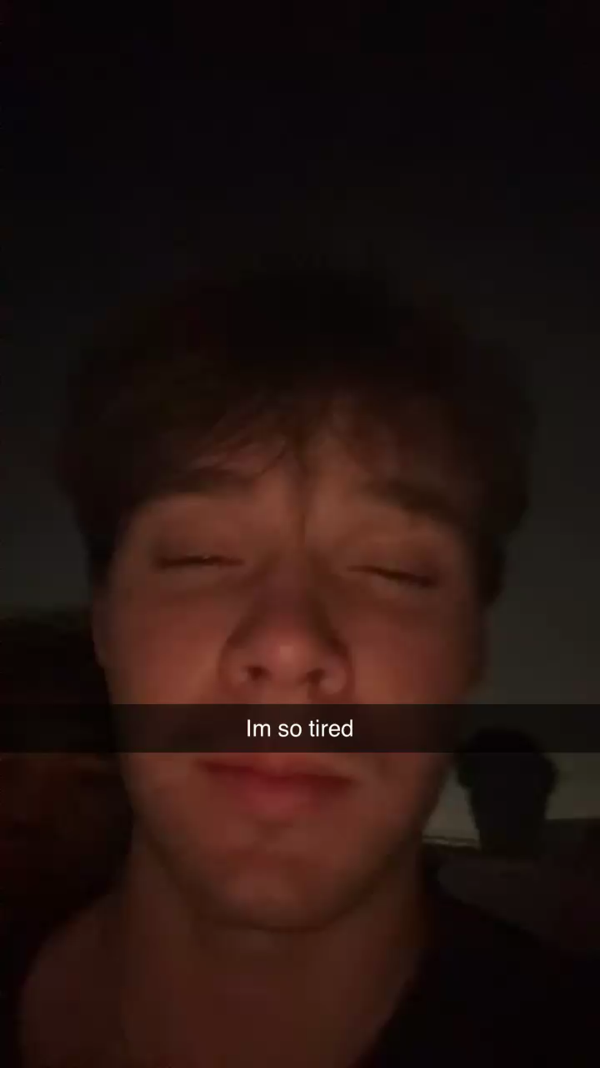
I went home to Los Angeles and went to a rave

Slide 25
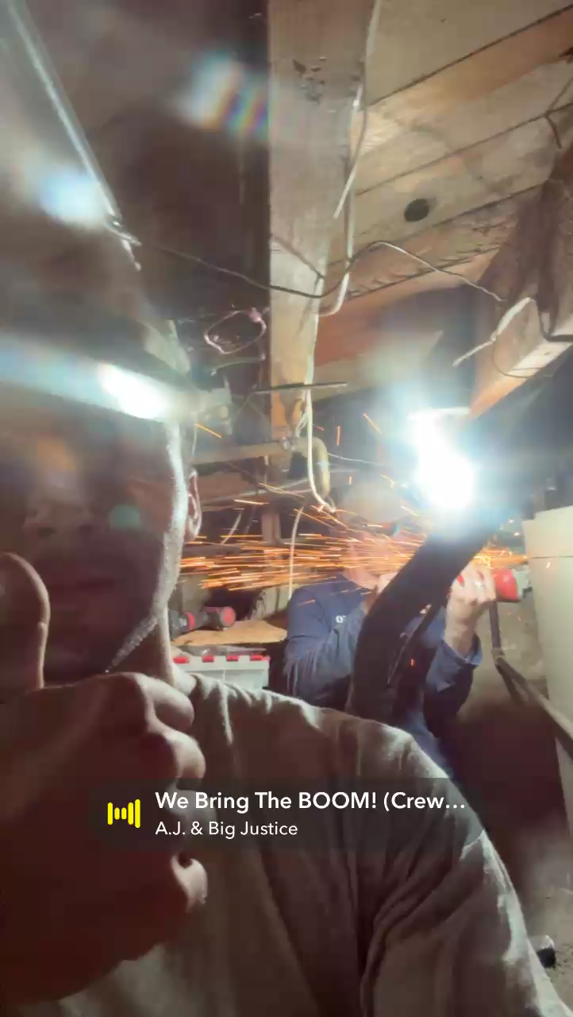
The same weekend I went home I was able to help my company with work, we installed an air conditioning unit

Slide 26

Thank you

